Slide 1

State of Elementary School Education in India
TEAM MICHIGAN
Data Understanding & Preparation : PGPDM Univ. of Chicago

Slide 2
OBJECTIVE & MOTIVATION –
The objective of the project was to study the state of elementary schools in India and learning outcomes that the education system enables.
We study the same over 2014-16
2014 was chosen since the enactment of Right to Education Act (which guarantees elementary education to all children between the ages of 6 -14 years) was to be completed latest by March 2015 by all state governments. We wanted to study the state of schools in the wake of an expected completion of targets laid down by the Act.

Slide 3
STRUCTURING DATASETS FOR THE STUDY – Normalization
1st Normal Form
There are no repeating groups | Yes
Data Atomic | Yes
Each Field has Unique Name | Yes
Primary Key | Yes
First Normal Form : Identifying Key Variables and assigning relevant Primary keys.
State ID | State Name | District Name | Type of School | Enrol_ School_ Type
State ID | State Name | District CD | District Name | School ID | Primary | Primary plus | Enrol_ School_ Type | Enrol_ Social_ Group | Enrol_ Primary_ Grade

Slide 4
STRUCTURING DATASETS FOR THE STUDY – Normalization
Second Normal Form : Separating master table into smaller tables concerning one variable type each
2st Normal Form
First Normal Form | Yes
All non-Key attributes are dependent on all parts of Primary | Yes
Eliminate Partial Dependencies | Yes
State ID | State Name | District CD | District Name | School ID | Primary | Primary plus | Enrol_ School_ Type | Enrol_ Social_ Group | Enrol_ Primary_ Grade
State ID | State Name
District CD | District Name | State ID
School_ID | Primary | Primary Plus | Upper Primary Plus | Enrol_ School_ Type | Enrol_ Social_ Group | Enrol_Primary_ Grade | District_ID

Slide 5
STRUCTURING DATASETS FOR THE STUDY – Normalization
Third Normal Form : Separating master table into smaller tables concerning one variable type each
3rd Normal Form
First Normal Form | Yes
Second Normal Form | Yes
Eliminate Transitive Dependencies | Yes
School_ID | Primary | Primary Plus | Upper Primary Plus | Enrol_ School_ Type | Enrol_ Social_ Group | Enrol_Primary_ Grade | District_ID
Enrol_Social_grp_ID | Repeater_Primary | Repeater_Upper_ Primary | School_ID | District_ID
School_ID | Primary | Primary Plus | Upper Primary Plus | District_ID
Enrol_School_Type_ID | Primary_Grade_ Enrol | Upper_Primary_ Grade_Enrol | School_ID | District_ID

Slide 6
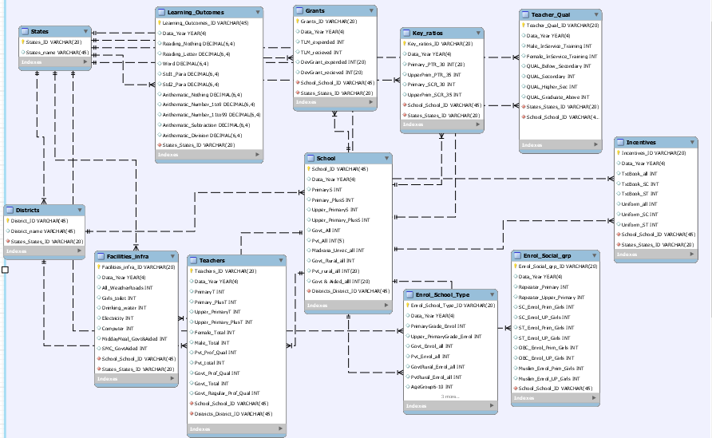
STRUCTURING DATASETS FOR THE STUDY – ER diagram
The ER Diagram maps the 12 tables that were used for the project.
The Tables include:
School Table – information on types of schools by management and level of education imparted.
Teacher table – covers teachers teaching in different school types and total number of teachers by gender.
The Enrollment by School Type covers enrollment by diff types of schools
Enrollment by social group likewise has data one enrollment by gender and social groups.
Teacher qualification table has information on number of qualified teachers by type of school and in-service training received.
The tables on Grants, Infrastructure, incentives record data on specific aspects as the name suggests, per district

Slide 7
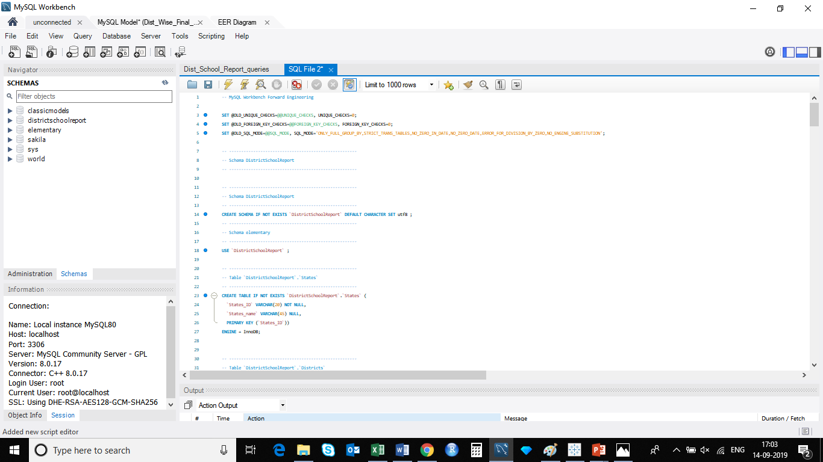
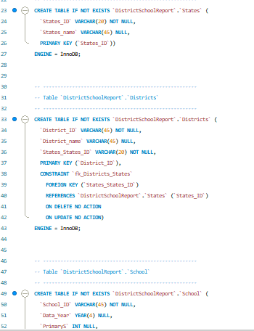
The panels show a snapshot of the scripts used to create Forward Engineer the ER Diagram.
– Forward Engineering the ER diagram

Slide 8
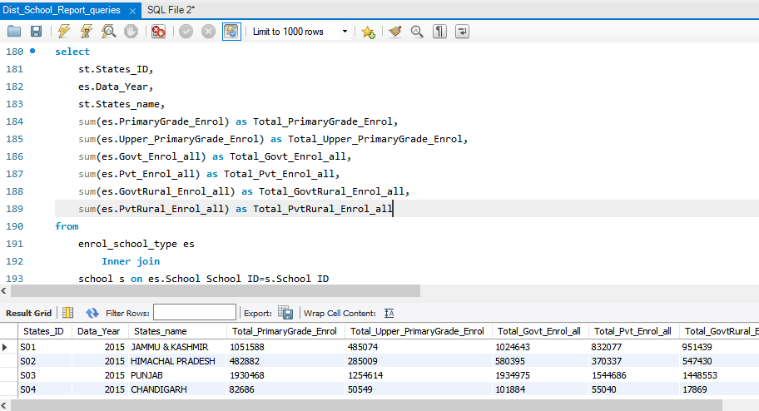
The panels show a snapshot of the scripts used to create Forward Engineer the ER Diagram.
Running Queries– Basic Summary for variables

Slide 9
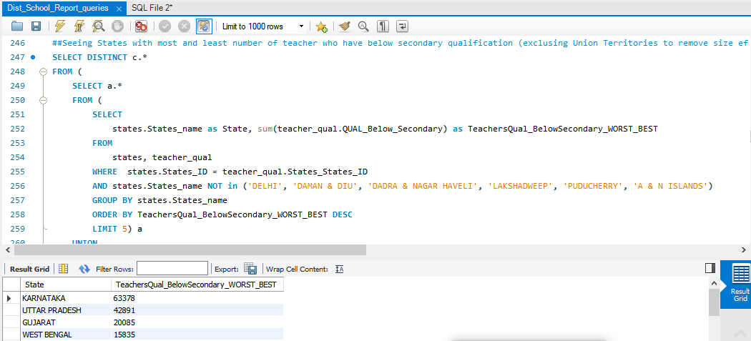
The panels show a snapshot of the scripts used to create Forward Engineer the ER Diagram.
Running Queries– Cross-tabs to see inter-relationship between variables

Slide 10
Small things to remember( for the team) & Learnings along the way
Data Preparation: Removed many unnecessary fields from original tables.
Data Cleanup: Removed merged similar columns.
Data Transformation: Transformed Date values in columns to Year.
Data Loading: Used a .csv file import. Issues we encountered centred around file size, data types.
Troubleshooting/lessons learned: We used of data_year instead of Year as Year is a keyword, removing the bidirectional relationships in ER diagram, saving the schema, forward engineering the ER model.

Slide 11

Data Visualization using Tableau

Slide 12
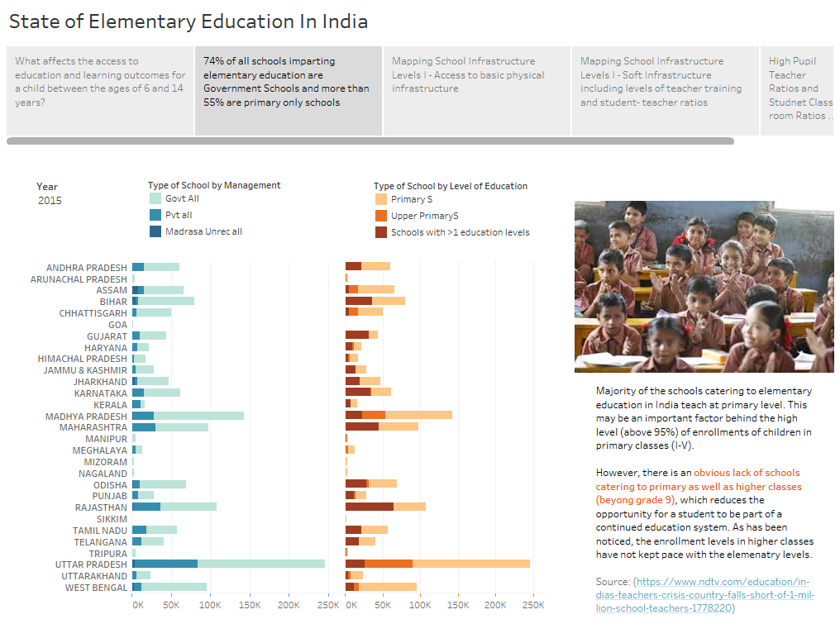

Slide 13
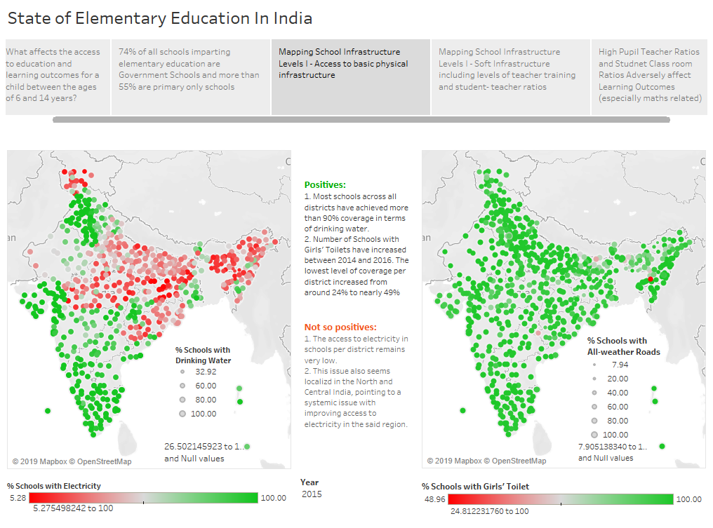

Slide 14
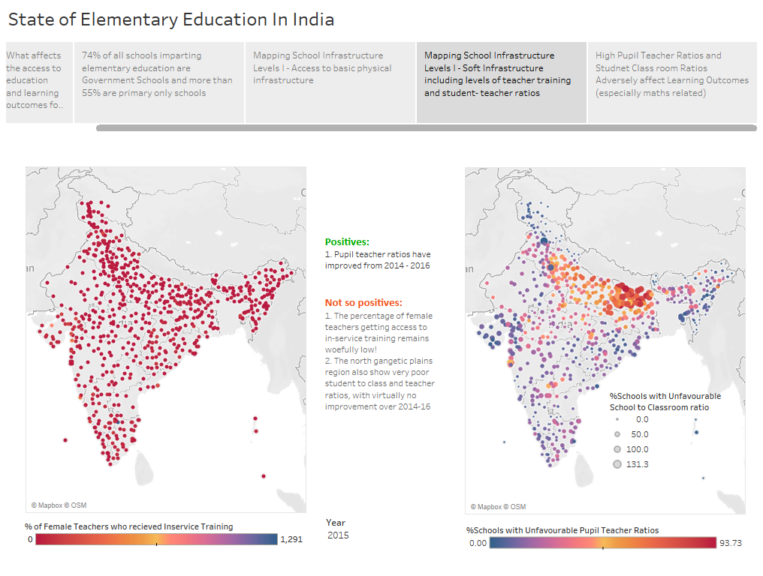

Slide 15
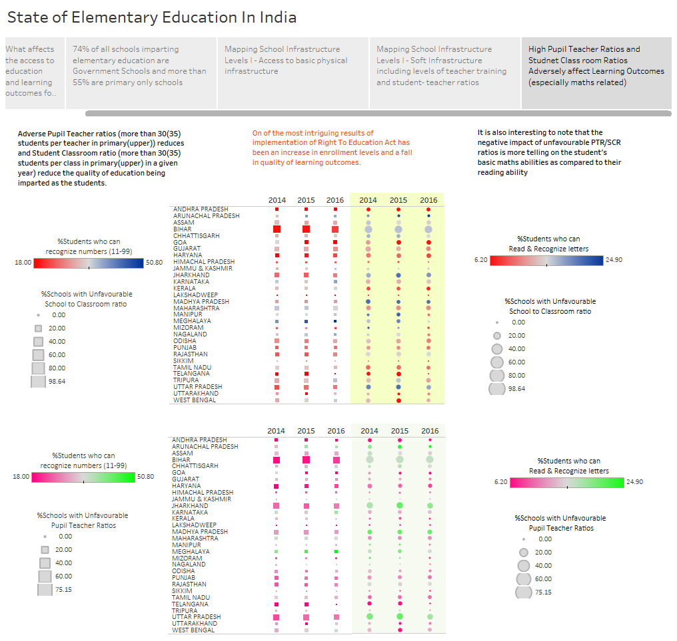

Slide 16
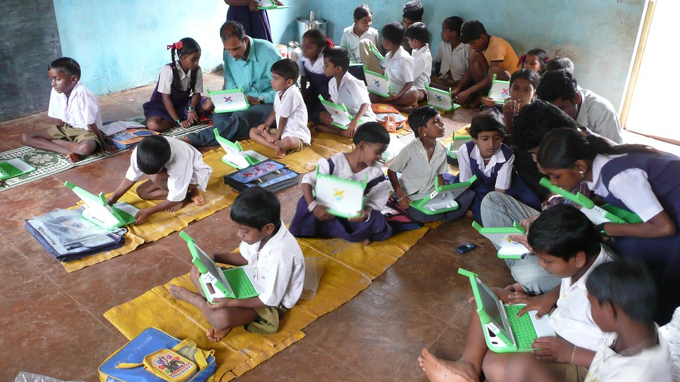
THANK YOU

